Slide 1
Chapter 2 :: Combinational Logic Design
(조합 논리 설계)
Digital Design and Computer Architecture
David Money Harris and Sarah L. Harris
Lectured by Jeong-Gun Lee @ Hallym
Copyright © 2007 Elsevier
2-<<number>>

Slide 2
Chapter 2 :: Topics
Introduction (소개)
Boolean Equations (부울 식, 이진논리식)
Boolean Algebra (부울대수)
From Logic to Gates (논리에서 회로로…)
Multilevel Combinational Logic (다층 조합회로)
X’s and Z’s, Oh My (X와 Z?)
Karnaugh Maps (카르노 맵)
Combinational Building Blocks (조합회로 블록)
Timing (타이밍)
Copyright © 2007 Elsevier
2-<<number>>

Slide 3

Introduction
A logic circuit is composed of:
(논리 회로는 다음 등으로 이루어진다)
Inputs (입력)
Outputs (출력)
Functional specification (기능)
Timing specification (타이밍)
Copyright © 2007 Elsevier
2-<<number>>

Slide 4
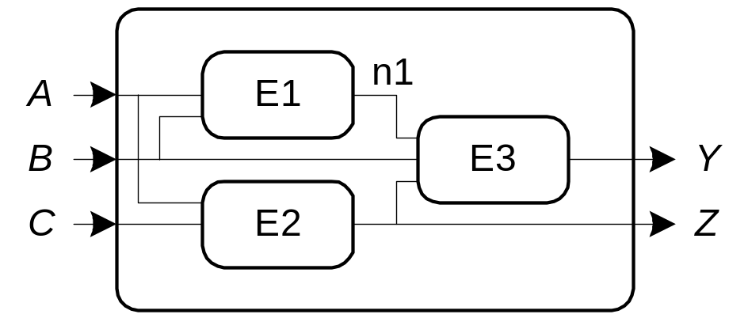
Circuits (회로)
Nodes (노드)
  Inputs: A, B, C
  Outputs: Y, Z
  Internal: n1
Circuit elements (회로 구성요소)
  E1, E2, E3
  Each a circuit
Copyright © 2007 Elsevier
2-<<number>>

Slide 5
Types of Logic Circuits
Combinational Logic (조합회로)
  Memoryless (메모리 없음)
  Outputs determined by current values of inputs
  (출력이 현재의 입력 값에 의해 결정됨)
Sequential Logic (조합회로)
  Has memory (메모리 가짐)
  Outputs determined by previous and current values of inputs
  (출력이 현재와 이전 입력에 의존하여 결정됨)
Copyright © 2007 Elsevier
2-<<number>>

Slide 6
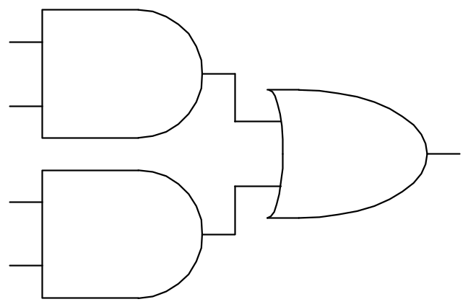
Rules of Combinational Composition
Every circuit element is itself combinational
Every node of the circuit is either designated as an input to the circuit or connects to exactly one output terminal of a circuit element
The circuit contains no cyclic paths: every path through the circuit visits each circuit node at most once
Example:
Copyright © 2007 Elsevier
2-<<number>>

Slide 7
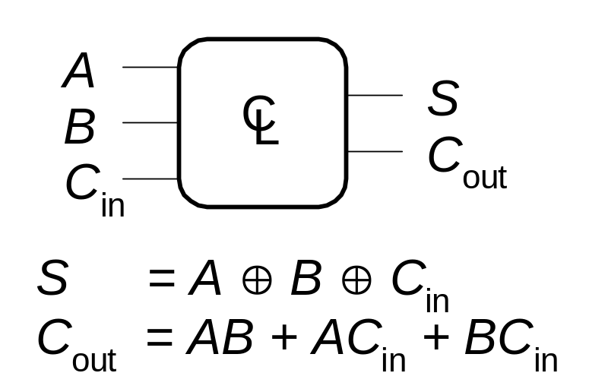
Boolean Equations (부울식)
Functional specification of outputs in terms of inputs
Example:
S = F(A, B, C_{in})
C_{out} = F(A, B, C_{in})
Copyright © 2007 Elsevier
2-<<number>>

Slide 8
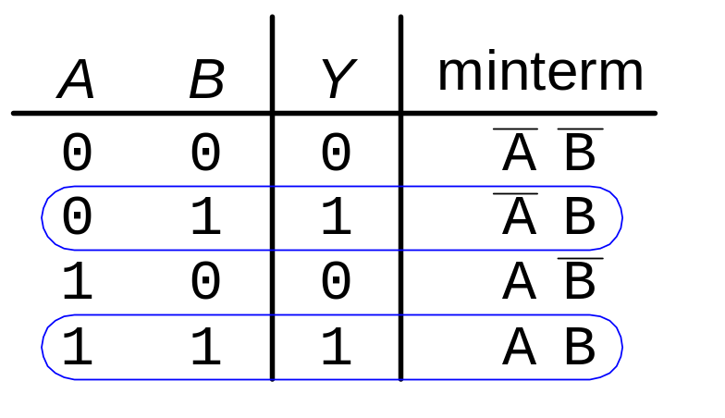
Sum-of-Products Form
Sum-of-Products (SOP) Form
All Boolean equations can be written in SOP form
Each row in a truth table has a minterm
A minterm is a product (AND) of literals
Each minterm is TRUE for that row (and only that row)
The function is formed by ORing the minterms for which the output is TRUE
Thus, a sum (OR) of products (AND terms)
Y = F(A, B, C) = AB + AB
Copyright © 2007 Elsevier
2-<<number>>

Slide 9
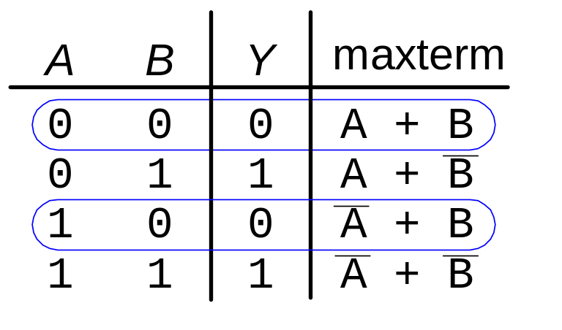
Sum-of-Products Form
Product-of-Sums (POS) Form
All Boolean equations can be written in POS form
Each row in a truth table has a maxterm
A maxterm is a sum (OR) of literals
Each maxterm is FALSE for that row (and only that row)
The function is formed by ANDing the maxterms for which the output is FALSE
Thus, a product (AND) of sums (OR terms)
Y = F(A, B, C) = (A + B)(A + B)
Copyright © 2007 Elsevier
2-<<number>>

Slide 10
SOP = POS ?
Y = F(A, B, C) = AB + AB
= (A + A)B = 1B = B
= (1+A+A)B = B + AB + AB
Y = F(A, B, C) = (A + B)(A + B)
= AA + AB + AB + BB
= AB + AB + B
= (A+A+1)B = 1B = B
Copyright © 2007 Elsevier
6-<<number>>

Slide 11

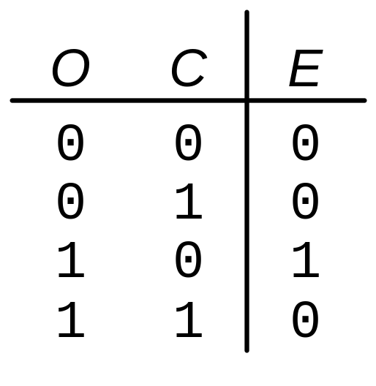
Boolean Equations Example
You are going to the cafeteria for lunch
  You won’t eat lunch (E)
  If it’s not open (O) or
  If they only serve corndogs (C)
Write a truth table for determining if you will eat lunch (E).
Copyright © 2007 Elsevier
2-<<number>>

Slide 12
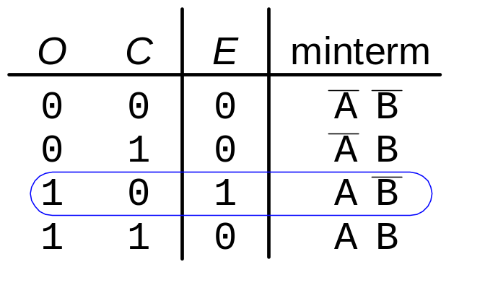
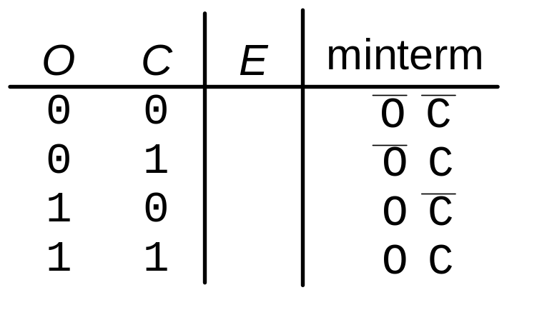
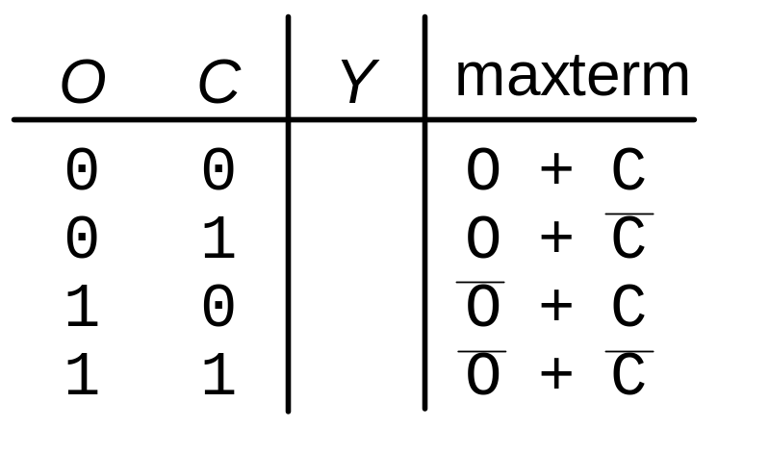
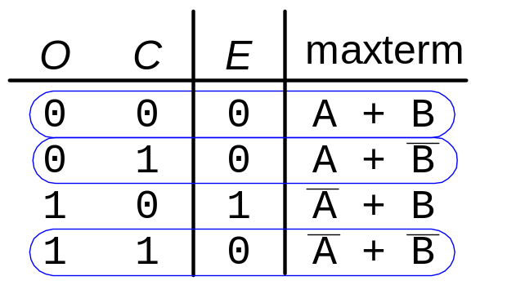
SOP & POS Form
SOP – sum-of-products
POS – product-of-sums
Y = AB
Y = (A + B)(A + B)(A + B)
Copyright © 2007 Elsevier
2-<<number>>

Slide 13
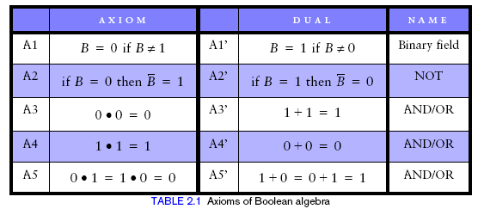
Boolean Algebra
Set of axioms and theorems to simplify Boolean equations
Like regular algebra, but in some cases simpler because variables can have only two values (1 or 0)
Axioms and theorems obey the principles of duality:
  ANDs and ORs interchanged, 0’s and 1’s interchanged
Copyright © 2007 Elsevier
2-<<number>>

Slide 14
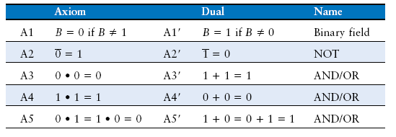
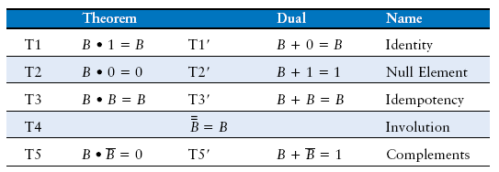
Boolean Axioms and Theorems
Copyright © 2007 Elsevier
2-<<number>>

Slide 15
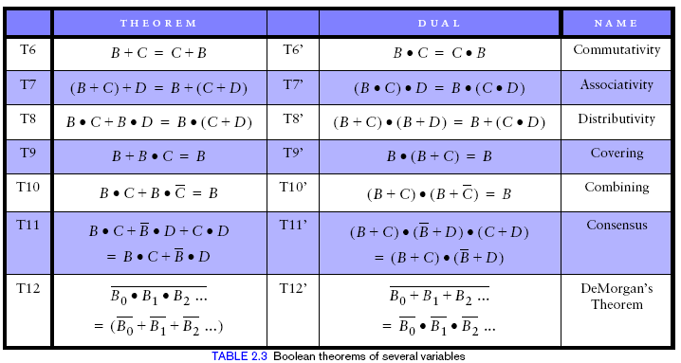
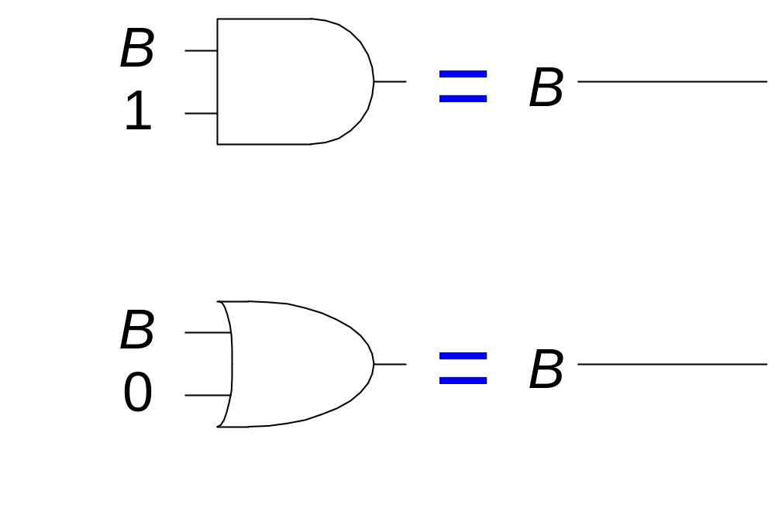
T1: Identity Theorem
B 1 = B
B + 0 = B
Copyright © 2007 Elsevier
2-<<number>>

Slide 16
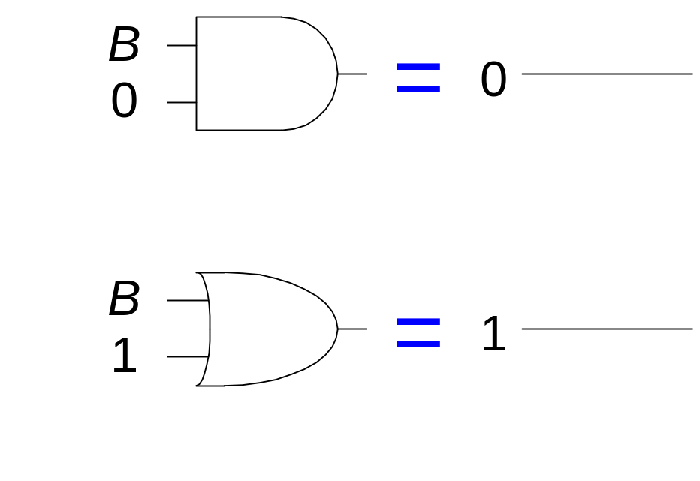
T2: Null Element Theorem
B 0 = 0
B + 1 = 1
Copyright © 2007 Elsevier
2-<<number>>

Slide 17
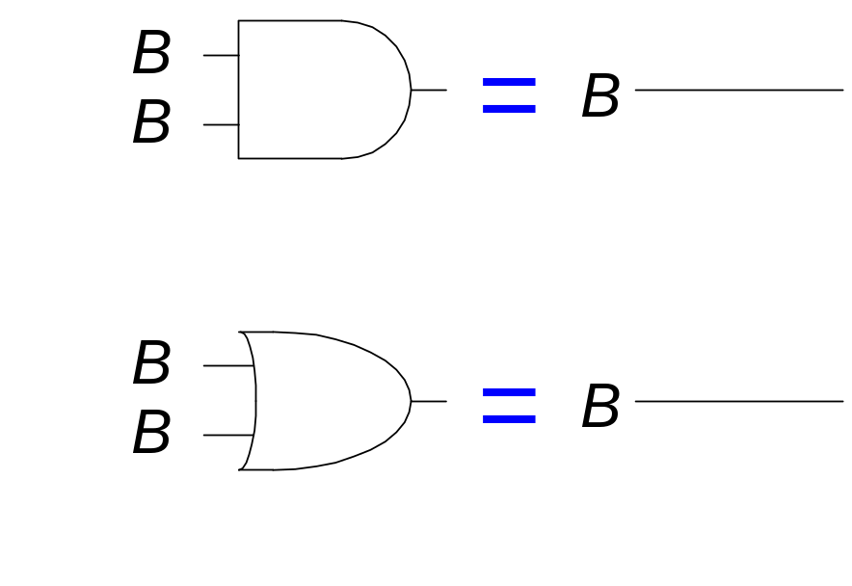
T3: Idempotency Theorem
B B = B
B + B = B
Copyright © 2007 Elsevier
2-<<number>>

Slide 18
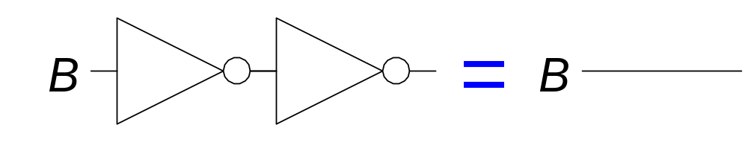
T4: Identity Theorem
B = B
Copyright © 2007 Elsevier
2-<<number>>

Slide 19
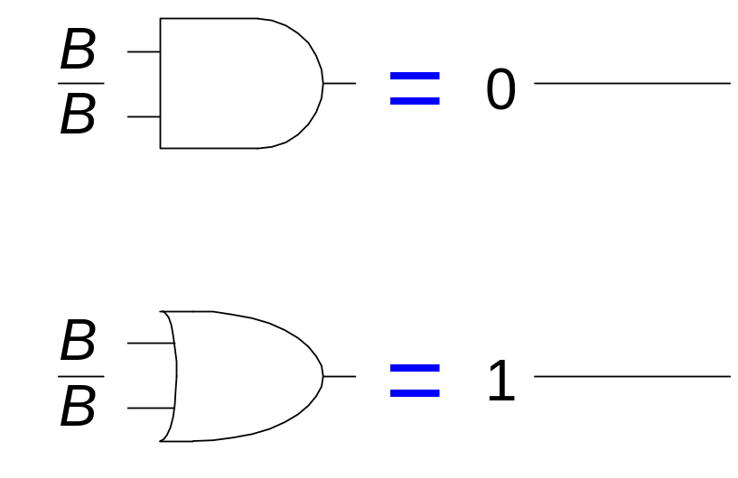
T5: Complement Theorem
B B = 0
B + B = 1
Copyright © 2007 Elsevier
2-<<number>>

Slide 20
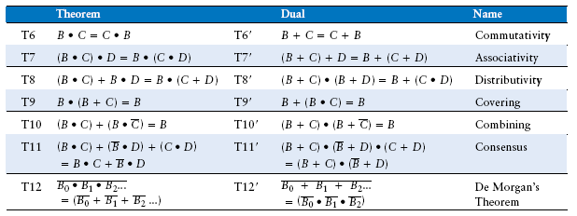
Boolean Theorems of Several Variables
Copyright © 2007 Elsevier
2-<<number>>

Slide 21
Simplifying Boolean Expressions: Example 1
Y = AB + AB
= B(A + A) T8
= B(1) T5’
= B T1
Copyright © 2007 Elsevier
2-<<number>>

Slide 22
Simplifying Boolean Expressions: Example 2
Y = B(AB + ABC)
= A(AB(1 + C)) T8
= A(AB(1)) T2’
= A(AB) T1
= (AA)B T7
= AB T3
Copyright © 2007 Elsevier
2-<<number>>

Slide 23
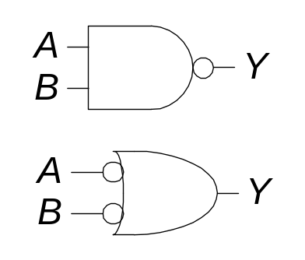
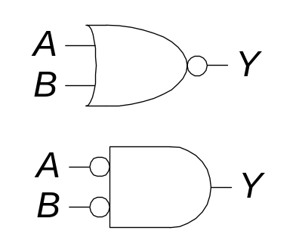
DeMorgan’s Theorem
Y = AB = A + B
Y = A + B = A B
Copyright © 2007 Elsevier
2-<<number>>

Slide 24
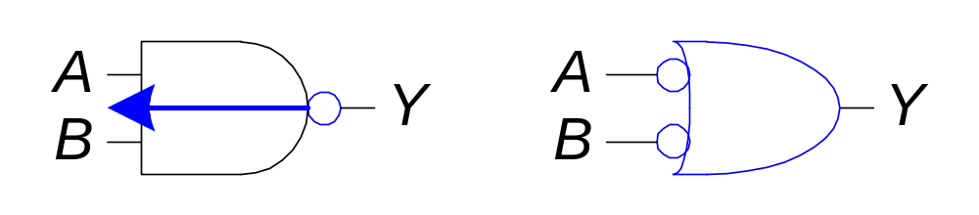
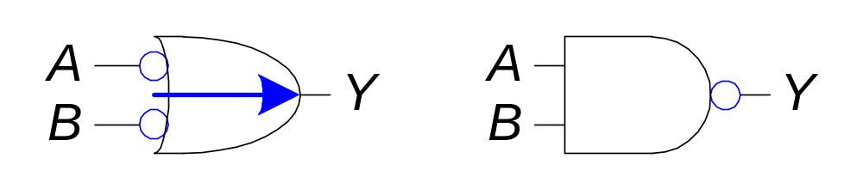
Bubble Pushing
Pushing bubbles backward (from the output) or forward (from the inputs) changes the body of the gate from AND to OR or vice versa.
Pushing a bubble from the output back to the inputs puts bubbles on all gate inputs.
Pushing bubbles on all gate inputs forward toward the output puts a bubble on the output and changes the gate body.
Copyright © 2007 Elsevier
2-<<number>>

Slide 25
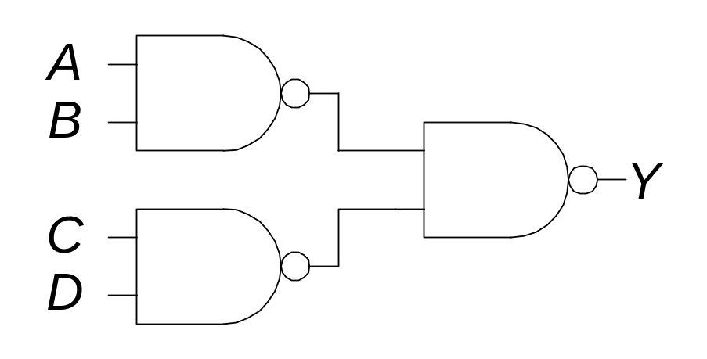
Bubble Pushing
What is the Boolean expression for this circuit?
Copyright © 2007 Elsevier
2-<<number>>

Slide 26
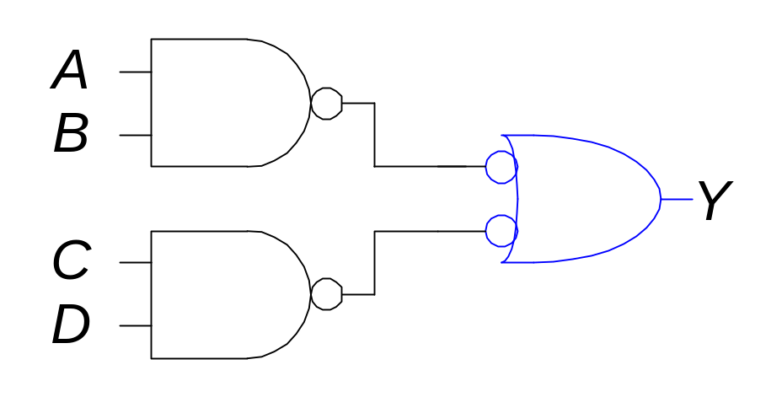
Bubble Pushing
What is the Boolean expression for this circuit?
Y = AB + CD
Copyright © 2007 Elsevier
2-<<number>>

Slide 27
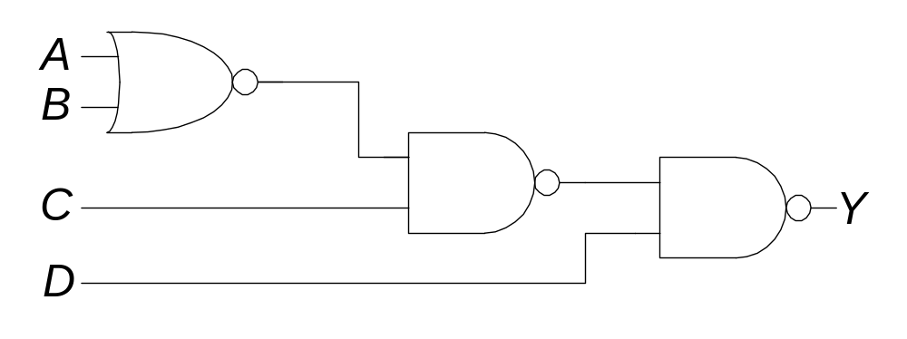
Bubble Pushing Rules
Begin at the output of the circuit and work toward the inputs.
Push any bubbles on the final output back toward the inputs.
Working backward, draw each gate in a form so that bubbles cancel.
Copyright © 2007 Elsevier
2-<<number>>

Slide 28
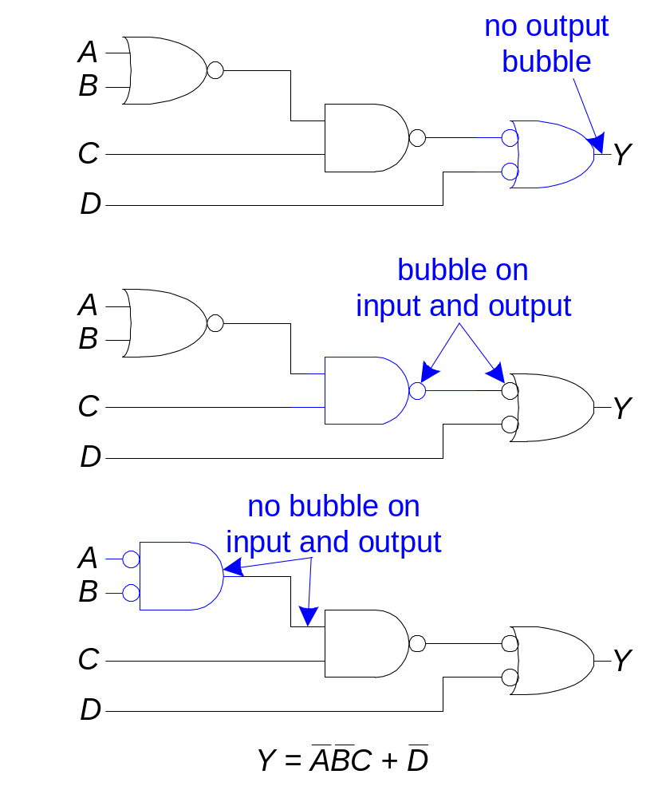
Bubble Pushing Rules
Copyright © 2007 Elsevier
2-<<number>>

Slide 29
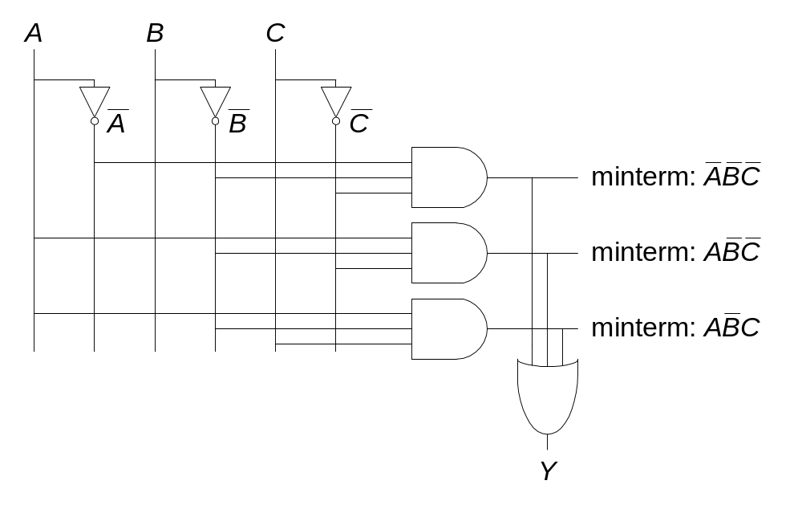
From Logic to Gates
Two-level logic: ANDs followed by Ors
Example: Y = ABC + ABC + ABC
Copyright © 2007 Elsevier
2-<<number>>

Slide 30
Circuit Schematic Rules
(회로 그림 규칙)
Inputs are on the left (or top) side of a schematic
입력은 왼쪽 또는 위쪽에…
Outputs are on the right (or bottom) side of a schematic
출력은 오른쪽 또는 아래쪽에…
Whenever possible, gates should flow from left to right
가능한 회로는 왼쪽에서 오른쪽으로 데이터가 흐르게…
Straight wires are better to use than wires with multiple corners
가능하면 선은 일직선으로…
Copyright © 2007 Elsevier
2-<<number>>

Slide 31
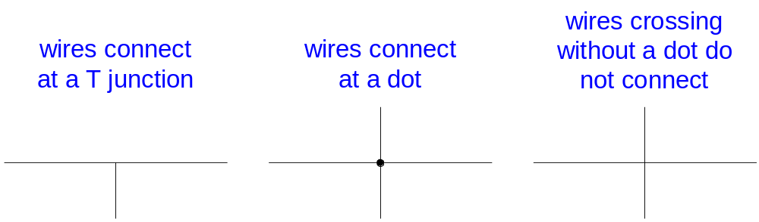
Circuit Schematic Rules (cont.)
Wires always connect (연결) at a T junction
A dot where wires cross indicates a connection between the wires
Wires crossing without a dot make no connection
Copyright © 2007 Elsevier
2-<<number>>

Slide 32
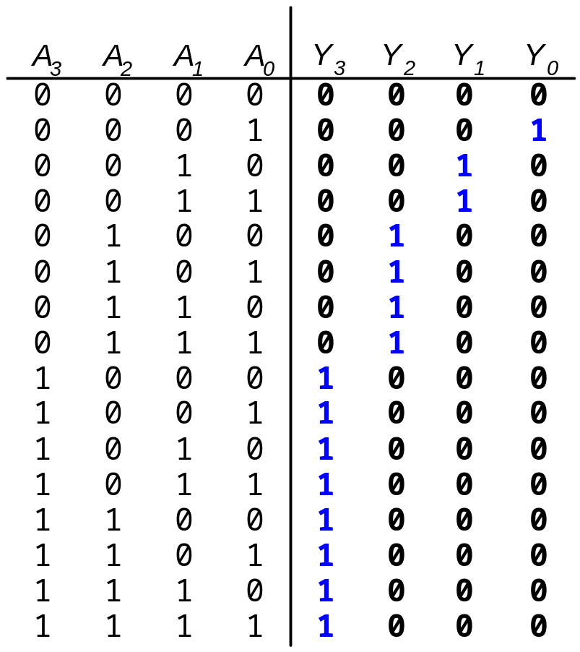
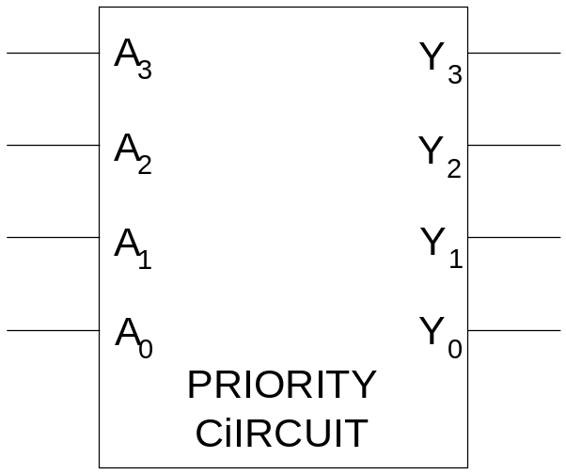
Multiple Output Circuits
Copyright © 2007 Elsevier
2-<<number>>

Slide 33
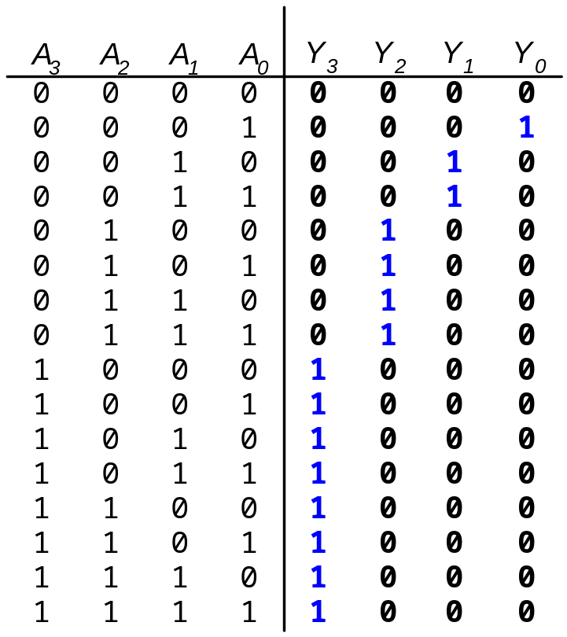
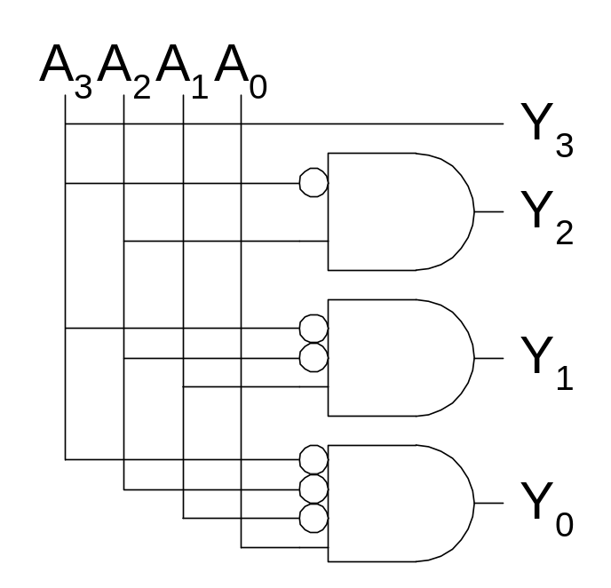
Priority Encoder Hardware
Copyright © 2007 Elsevier
2-<<number>>

Slide 34
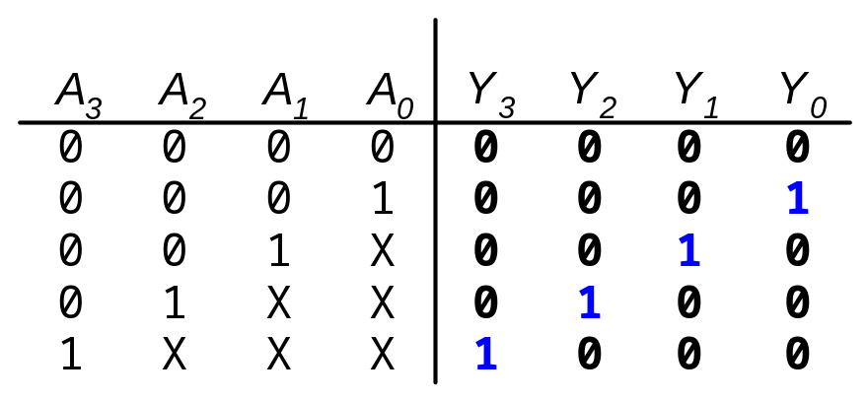
Don’t Cares
Copyright © 2007 Elsevier
2-<<number>>

Slide 35
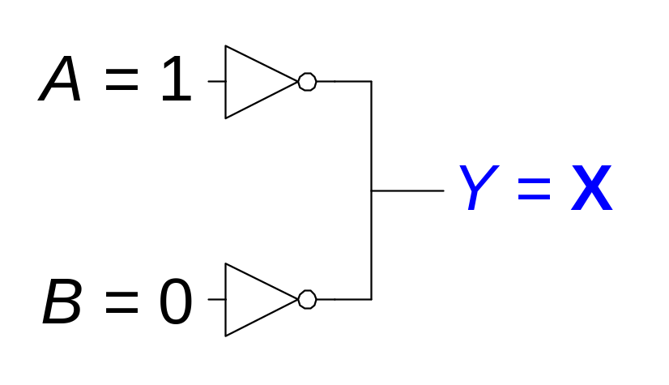

Contention: X
Contention: circuit tries to drive the output to 1 and 0
Copyright © 2007 Elsevier
2-<<number>>

Slide 36
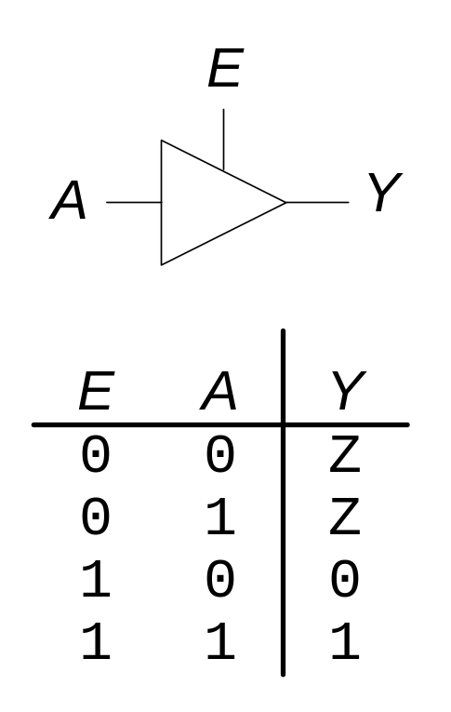
Floating: Z
Floating, high impedance, open, high Z
Output is not connected to the input
Tristate Buffer
Copyright © 2007 Elsevier
2-<<number>>

Slide 37
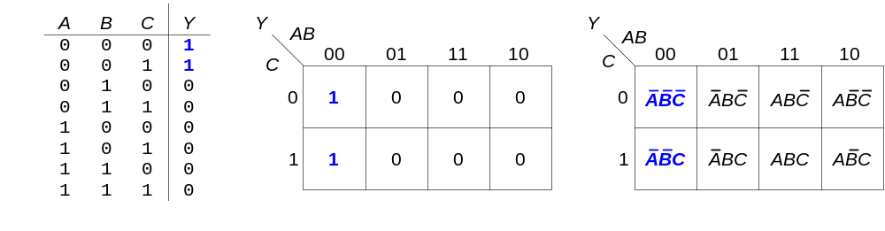
Karnaugh Maps (K-Maps)
Boolean expressions can be minimized by combining terms
K-maps minimize equations graphically
PA + PA = P
Copyright © 2007 Elsevier
2-<<number>>

Slide 38
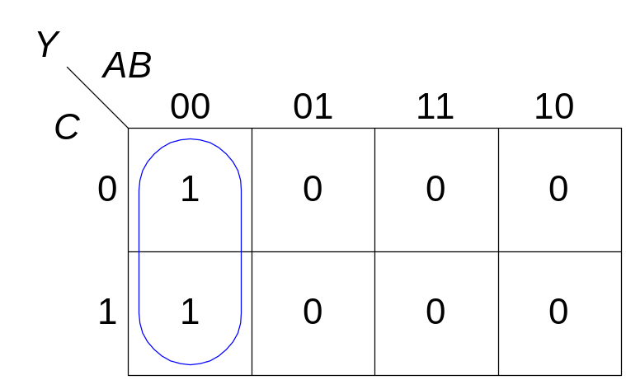
K-map
Circle 1’s in adjacent squares
In the Boolean expression, include only the literals whose true and complement form are not in the circle
Y = AB
Copyright © 2007 Elsevier
2-<<number>>

Slide 39
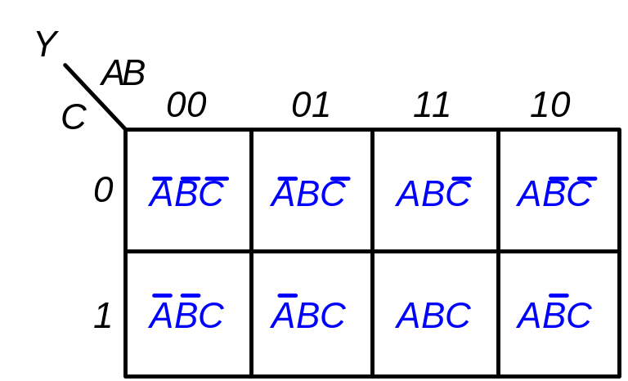
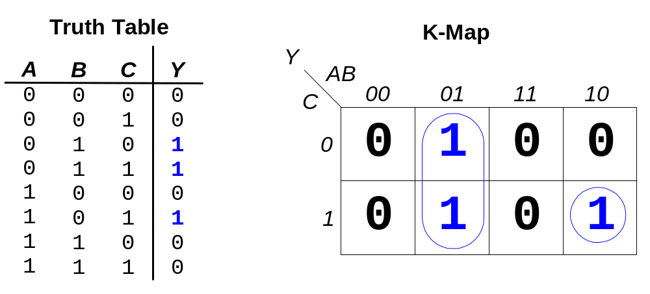
K-map Example
Y = AB + ABC
Copyright © 2007 Elsevier
2-<<number>>

Slide 40
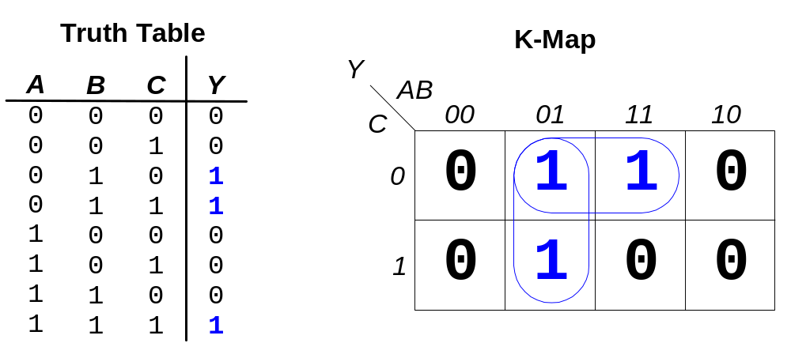
3-input K-map
Y = AB + BC
Copyright © 2007 Elsevier
2-<<number>>

Slide 41
K-map Definitions
Complement: variable with a bar over it
A, B, C
Literal: variable or its complement
A, A, B, B, C, C
Implicant: product of literals
ABC, AC, BC
Prime implicant: implicant corresponding to the largest circle in a K-map
Copyright © 2007 Elsevier
2-<<number>>

Slide 42
K-map Rules
Each circle must span a power of 2 (i.e. 1, 2, 4) squares in each direction
Each circle must be as large as possible
A circle may wrap around the edges of the K-map
A one in a K-map may be circled multiple times
A “don't care” (X) is circled only if it helps minimize the equation
Copyright © 2007 Elsevier
2-<<number>>

Slide 43
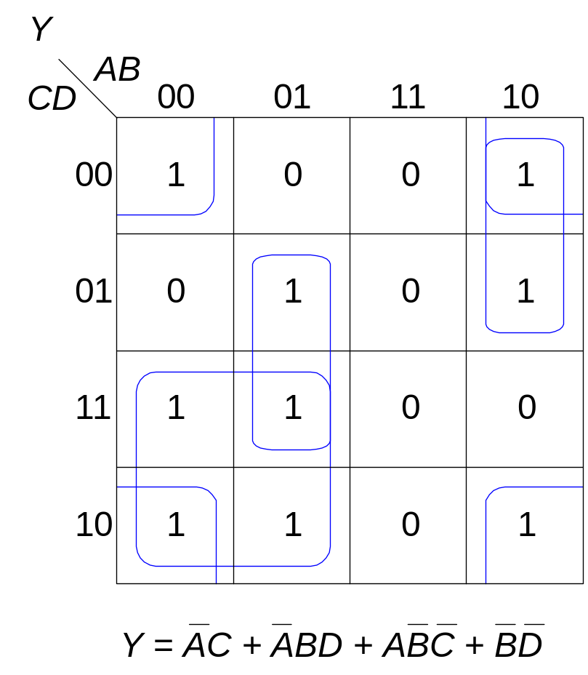
4-input K-map
Copyright © 2007 Elsevier
2-<<number>>

Slide 44
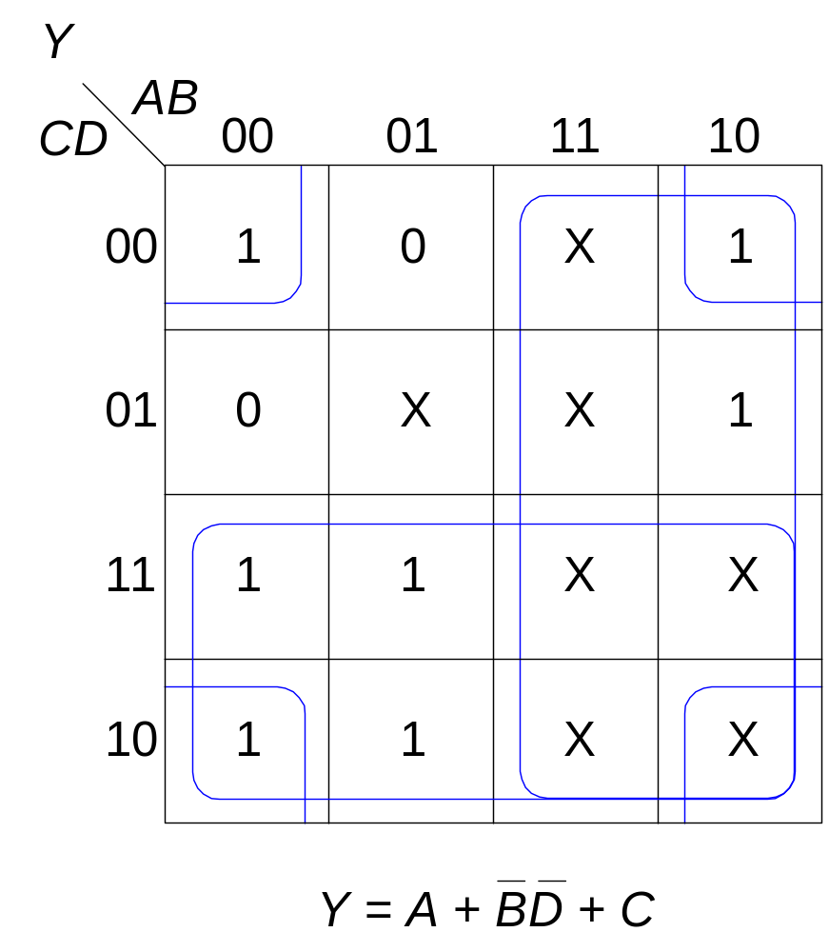
K-Maps with Don’t Cares
Copyright © 2007 Elsevier
2-<<number>>

Slide 45
Combinational Building Blocks
Multiplexers (멀티플렉서)
Decoders (디코더)
Copyright © 2007 Elsevier
2-<<number>>

Slide 46
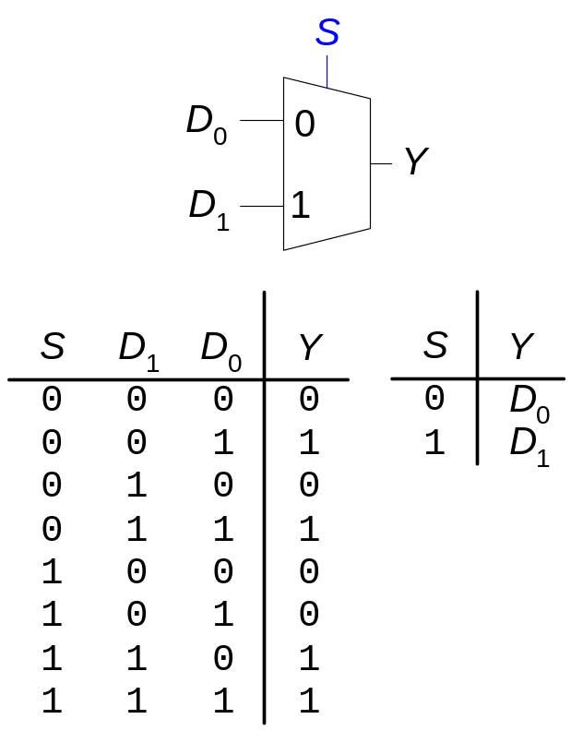
Multiplexer (Mux:먹스)
Selects between one of N inputs to connect to the output.
log₂N-bit select input – control input
Example: 2:1 Mux
Copyright © 2007 Elsevier
2-<<number>>

Slide 47
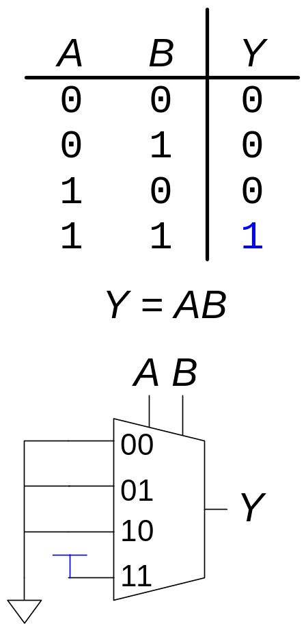
Logic using Multiplexers
Using the mux as a lookup table – AND-gate
(먹스를 참조테이블로 사용하여 논리게이트 만들기)
Copyright © 2007 Elsevier
2-<<number>>

Slide 48
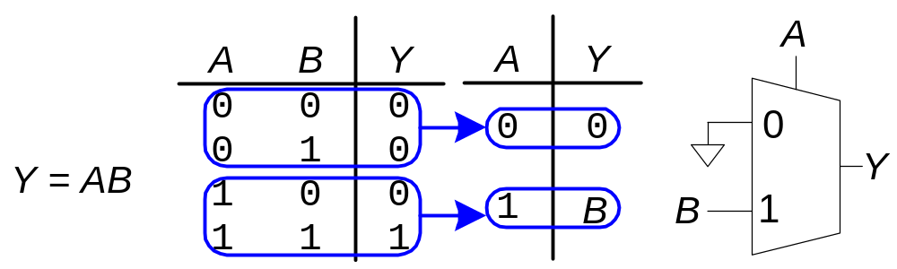
Logic using Multiplexers
Reducing the size of the mux (먹스의 사이즈 줄이기)
Copyright © 2007 Elsevier
2-<<number>>

Slide 49
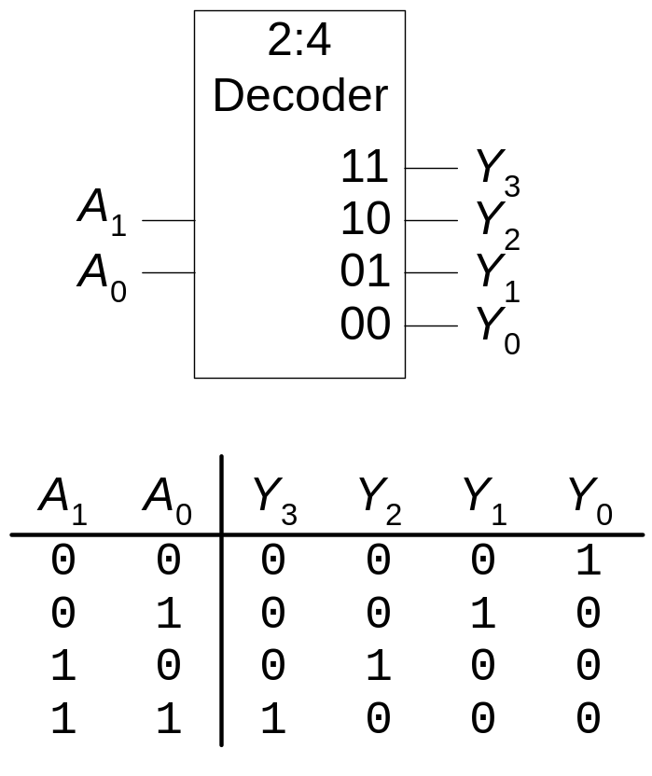
Decoders
N inputs, 2^{N} outputs
One-hot outputs: only one output HIGH at once
출력 신호들 중 단 하나의 값만 ‘1’을 갖는다.
Copyright © 2007 Elsevier
2-<<number>>

Slide 50
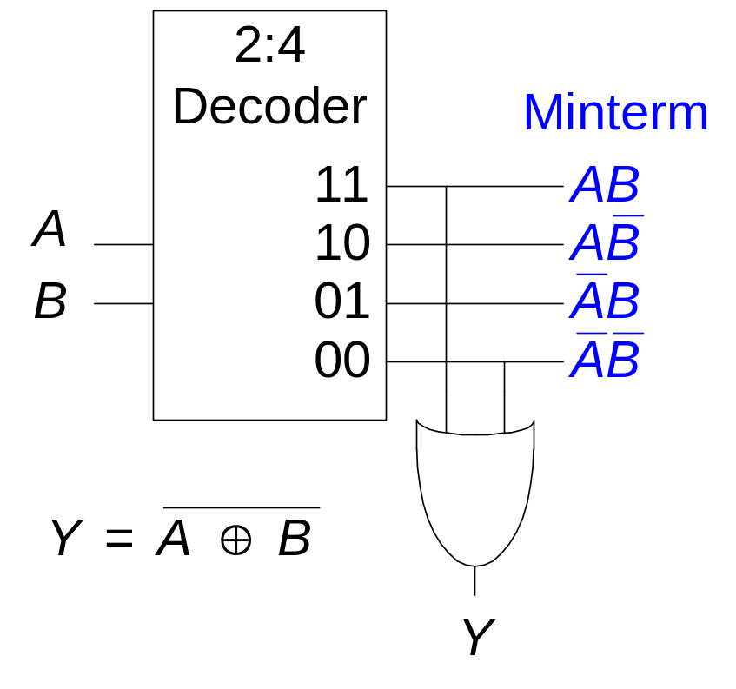
Logic using Decoders
(디코더를 이용한 회로)
OR minterms
Copyright © 2007 Elsevier
2-<<number>>

Slide 51
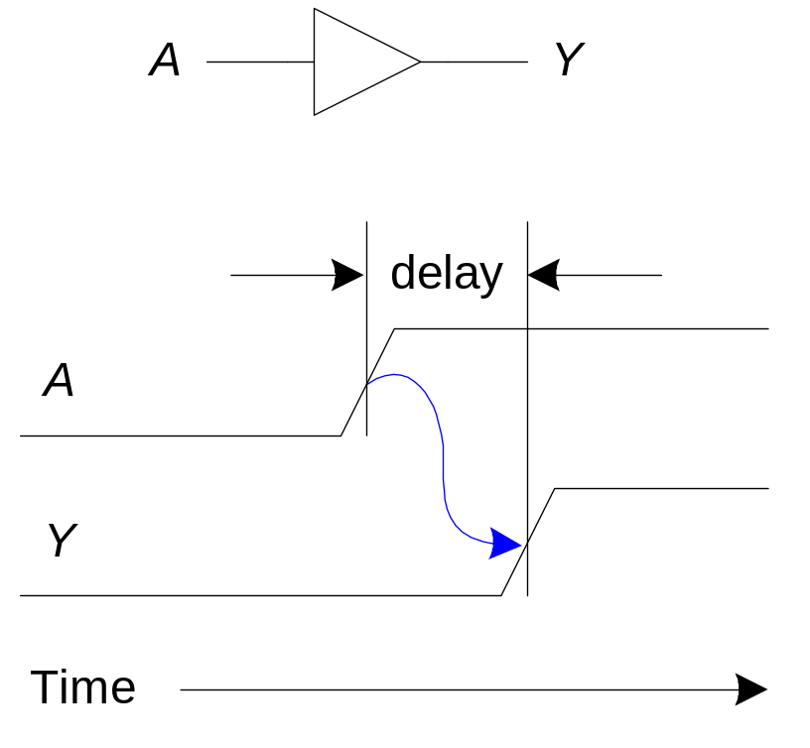
Timing (타이밍)
Delay between input change and output changing
One of the biggest challenges in circuit design: making the circuit fast
Copyright © 2007 Elsevier
2-<<number>>

Slide 52


Propagation & Contamination Delay
(전파 및 혼합 지연)
Propagation Delay: t_{pd} = max delay from input to output
Contamination Delay: t_{cd} = min delay from input to output
Propagation delay: t_{pd} = max delay from input to output
Contamination delay: t_{cd} = min delay from input to output
Copyright © 2007 Elsevier
2-<<number>>

Slide 53
Propagation & Contamination Delay
Delay is caused by
  Capacitance and resistance in a circuit
  Speed of light limitation
Reasons why t_{pd} and t_{cd} may be different:
  Different rising and falling delays
  Multiple inputs and outputs, some of which are faster than others
  Circuits slow down when hot and speed up when cold
Delay is caused by
  Capacitance and resistance in a circuit
  Speed of light limitation
Reasons why tpd and tcd may be different:
  Different rising and falling delays
  상승지연과 하강지연이 다르다.
  Multiple inputs and outputs, some of which are faster than others
  입력이나 출력이 여러 개 있을 경우, 서로간의 속도 차가 있다.
  Circuits slow down when hot and speed up when cold
  회로는 뜨거울 때 속도가 느리고, 차가울 때 속도가 빨라진다.
Copyright © 2007 Elsevier
2-<<number>>

Slide 54


Critical (Long) and Short Path
Critical and Short Paths
(임계 경로 및 짧은 경로)
Critical (Long) Path: t_{pd} = 2t_{pd_AND} + t_{pd_OR}
Short Path: t_{cd} = t_{cd_AND}
Copyright © 2007 Elsevier
2-<<number>>

Slide 55
Glitches
Glitches (글리치)
Glitch: when a single input change causes multiple output changes
Glitches don’t cause problems because of synchronous design conventions (which we’ll talk about in a bit)
But it’s important to recognize a glitch when you see one in timing diagrams
A glitch occurs when a single input change causes multiple output changes
(단일 입력의 변화가 다수의 출력의 유도할때)
Glitches don’t cause problems because of synchronous design conventions (which we’ll talk about in Chapter 3)
(동기식 회로에서는 문제를 야기하지 않음)
But it’s important to recognize a glitch when you see one in simulations or on an oscilloscope
(하지만 존재에 대해서 이해하고 해석할 능력은 필요함)
Copyright © 2007 Elsevier
2-<<number>>

Slide 56


Glitch Example
Copyright © 2007 Elsevier
2-<<number>>

Slide 57

Glitch Example (cont.)
Copyright © 2007 Elsevier
2-<<number>>

Slide 58




Glitches: Example
Glitch Example (cont.)
Copyright © 2007 Elsevier
2-<<number>>

Slide 59
Glitches: Example
Why Understand Glitches?
Recognize them when look at timing diagrams in (simulations or on an oscilloscope)
Can’t get rid of all glitches – simultaneous transitions on multiple inputs can also cause glitches
Copyright © 2007 Elsevier
2-<<number>>

